Slide 1

Introduction to XML
XML, or Extensible Markup Language, is a versatile data format used to store and transmit structured information. It provides a standardized way to represent data, making it easier to exchange information across different systems and applications.

Slide 2

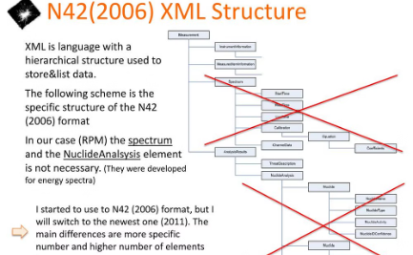
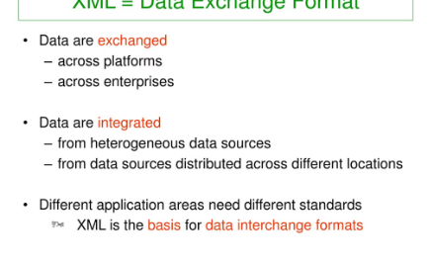
What is XML?
Definition
Structure
Data Exchange
XML, or Extensible Markup Language, is a flexible text-based format for creating, organizing, and sharing structured data across different systems and applications.
XML documents are composed of elements, tags, and attributes that define the data and its hierarchy, allowing for the clear communication of information.
XML enables the exchange of data between diverse systems and applications, making it a crucial tool for integrating information across the digital landscape.

Slide 3
XML Structure and Syntax
XML Tags
XML Attributes
XML Hierarchy
XML uses custom tags to define the structure of data. Tags are enclosed in angle brackets, like content. Tags can be paired (opening and closing) or self-closing.
Attributes provide additional information about an XML element. They are included inside the opening tag, using the format attribute="value".
XML data is organized in a hierarchical tree structure, with parent-child relationships between elements. This allows for complex, nested data models.

Slide 4
XML Tags and Attributes
1
Elements and Tags
2
Attributes
XML uses tags to define elements, which are the building blocks of an XML document. Tags are enclosed in angle brackets, like <element>.
Attributes provide additional information about an element. They are placed inside the opening tag and consist of a name-value pair, like name="value".
3
Well-Formed XML
4
Namespaces
For an XML document to be well-formed, it must have a single root element, properly nested tags, and attributes must be quoted.
Namespaces allow you to use the same element or attribute names in different contexts without conflicts. They are declared using the xmlns attribute.

Slide 5
XML Validation and Schemas
Well-Formed XML
XML Schemas
Ensuring XML documents are well-formed is crucial. They must adhere to strict syntax rules, with proper nesting of tags and balanced opening/closing elements.
Schemas define the structure and data types allowed in an XML document, acting as a blueprint for valid XML. They ensure consistency and facilitate data exchange.
Validation Process
Schema Languages
XML validation checks a document against its defined schema, identifying any errors or deviations. This process guarantees the XML adheres to application-specific requirements.
Popular schema languages include XML Schema (XSD), Document Type Definition (DTD), and Relax NG. Each has unique strengths for defining XML structures.

Slide 6




Parsing XML Data with Programming Languages
XML Parsing Libraries
Traversing the XML Tree
Error Handling
Robust XML parsing code should handle common issues like invalid XML syntax, missing elements, and namespace conflicts.
Popular libraries like DOM, SAX, and StAX allow you to read, navigate, and extract data from XML documents programmatically.
Traverse the hierarchical XML structure to access and manipulate specific elements, attributes, and text content.

Slide 7
Storing and Retrieving XML Data
Database Storage
File-based Storage
XML Databases
Caching and Indexing
Native XML databases are designed specifically to store and manage XML data. They provide advanced querying capabilities and schema-less storage, making them well-suited for XML-centric applications.
XML data can be stored in relational databases by mapping elements and attributes to database tables and columns. This allows for efficient querying and retrieval of XML data.
XML files can also be stored directly on a file system. This approach is simpler but may not scale as well for large data sets or complex XML structures.
Techniques like caching and indexing can be used to optimize the retrieval of XML data, improving performance and responsiveness for applications.

Slide 8
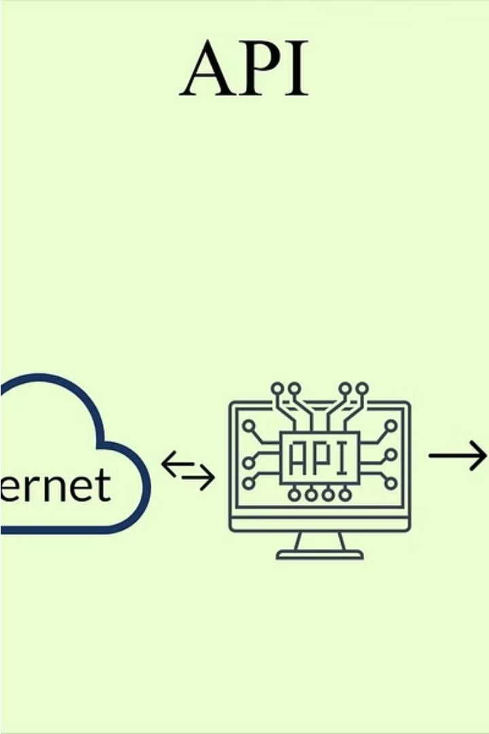
XML in Web Services and APIs
XML has become a crucial component in modern web services and APIs. It provides a standardized way to structure and exchange data between different applications and systems.
XML-based web services use XML to define the data formats and protocols for communication, allowing seamless integration and data exchange across platforms and programming languages.
APIs that leverage XML can easily share and consume data, enabling developers to build powerful, interoperable applications that work together to solve complex problems.

Slide 9
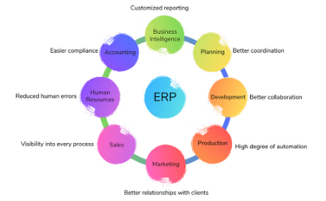
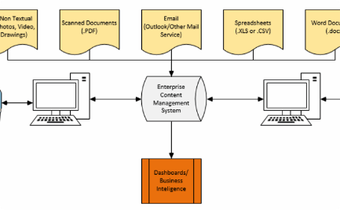

XML in Enterprise Applications
Data Integration
Content Management
Application Integration
XML enables seamless exchange of data between disparate enterprise systems, facilitating integrated workflows and real-time business intelligence.
XML-based content management systems empower organizations to efficiently store, manage, and publish structured content across multiple platforms.
XML's platform-independent nature simplifies integrating legacy systems with modern applications, unlocking new synergies and automation opportunities.

Slide 10
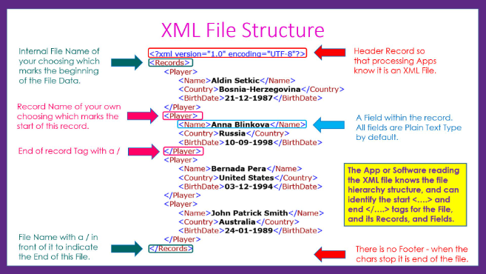
Conclusion and Real-World Examples
XML has become an invaluable tool in a wide range of real-world applications, from web services and APIs to enterprise data management. Its flexibility and extensibility make it an ideal choice for integrating diverse systems and exchanging complex data.
As we've explored, XML is used extensively in industries like healthcare, finance, and e-commerce to power mission-critical applications and streamline data exchange. Its adoption continues to grow as the need for robust, standards-based data interchange solutions increases.

